Slide 1
Multi‑Station Datalogger QC & Health Analysis
Presentation
Prepared by GAHIGI Robert
On 24th February 2026

Slide 2
Objectives
Evaluate data quality across multiple datalogger stations
Detect sensor faults, outages, and inconsistencies
Compare stations using temperature and precipitation behavior
Develop an overall station health score.

Slide 3
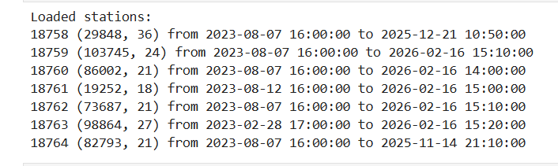
TIME FRAME : Analysis was performed on 7 data logger stations :18758,18759, 18760, 18761,18762,18763 and 18764

Slide 4
QC Methodology Overview
Step 1: Firstly, I performed datasets decoding of datalogger station respectively ( I developed a python script that helped in performing that task)
Step 2:Data parsing and time indexing
Step 3: Completeness (missingness) assessment
Step 4: Out‑of‑range and logical ordering checks
Step 5: Time‑gap/outage detection
Step 6: Stuck‑sensor diagnostics
Step 7: Cross‑station comparison and correlation analysis
Step 8: overall station health ranking

Slide 5
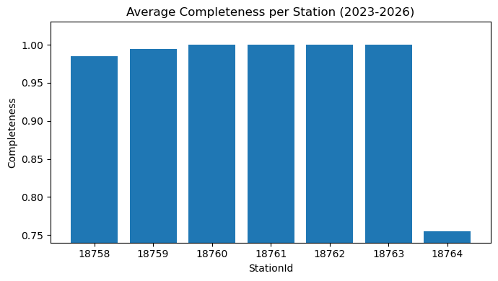
ANALYSIS 1: COMPLETENESS PLOT

Slide 6
INTERPRETATION
Measures proportion of available (non‑missing) data
Most stations show excellent completeness (>0.99)
Station 18764 shows reduced completeness (~0.76)
High completeness indicates stable data acquisition
Low completeness suggests outages or sensor downtime

Slide 7
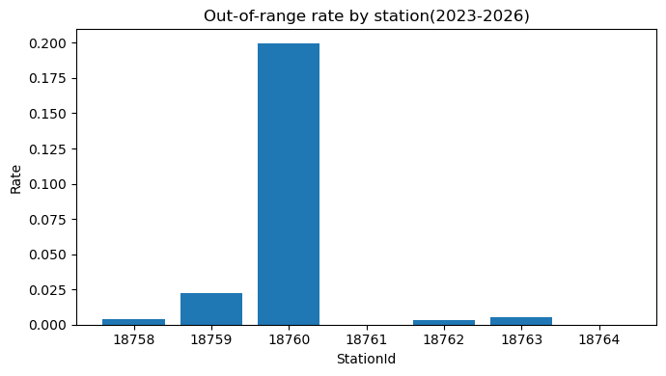
ANALYSIS 2: Out of range and Temperature statistics ordering

Slide 8
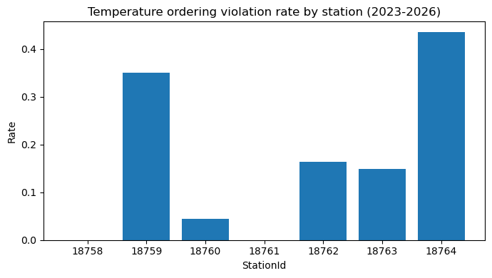
Temperature ordering check

Slide 9
Interpretation : Range & Ordering Checks
Out‑of‑range values detect physically impossible measurements or indicates that values are out of physically possible limits.
Min–Avg–Max ordering ensures logical consistency
High ordering violation rates suggest mapping or computation issues
Stations 18759 and 18764 show the most concern

Slide 10
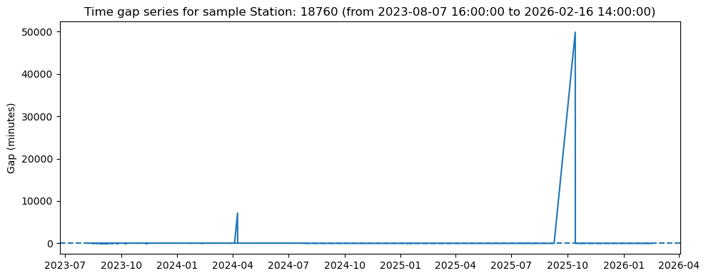
Time Gaps and outages

Slide 11
Analysis 3 — Time Gaps / Outages I took a sample of 18760 in visualizing
Evaluates continuity of data transmission
Large gaps indicate power, network, or logger interruptions
Operational reliability should be improved for affected stations

Slide 12
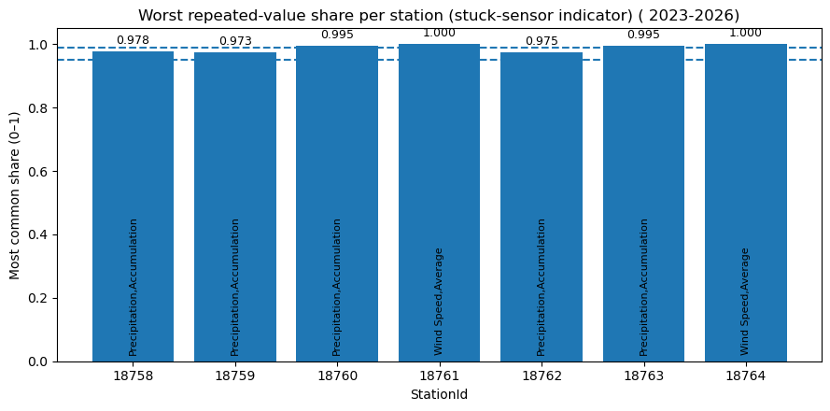
ANALYSIS 4: Stuck sensor detection

Slide 13
Interpretation
Repeated‑value analysis identifies frozen and malfunctional sensors
Share ≥ 0.95 indicates likely sensor stucking at constant value( sensor stalling).
Some stations like 18761 and 18764 show very high repetition signals
These sensors require field verification

Slide 14
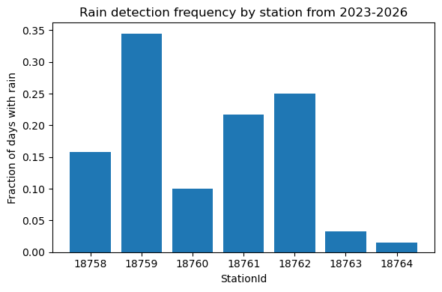
ANALYSIS 5:RAIN DETECTION FREQUENCY AND TEMPERATURE DAILY MEAN

Slide 15
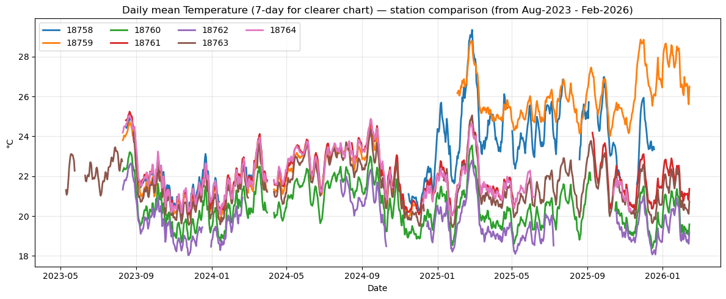

Slide 16
Analysis 5 — Interpretation
Daily temperature trends show overall network coherence
Minor warm/cool biases observed between stations
Rain detection frequency highlights potential gauge issues
Stations 18763 and 18764 show unusually low rain detection

Slide 17
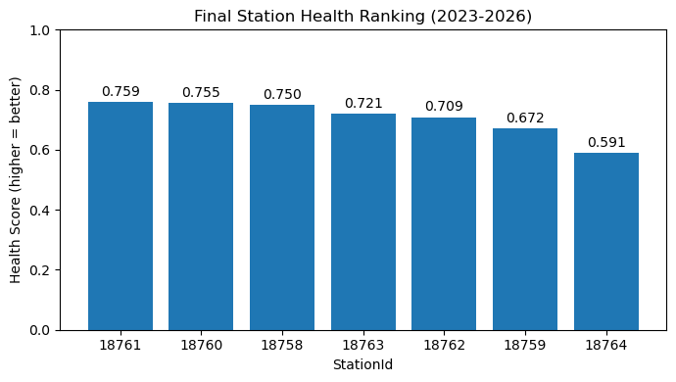
OVERALL, STATION HEALTH PLOT

Slide 18
OVERALL Station Health Ranking
Health score integrates multiple QC indicators
Higher score indicates better overall station reliability
Best performing stations: 18761 and 18760
Lowest score: Station 18764
Ranking supports maintenance prioritization

Slide 19
Key Recommendations
Immediate inspection of Station 18764 due many QC issues detected from the analysis.
Investigate ordering violations at Station 18759
Improve power/network stability for stations with large gaps
Verify sensors with high repeated‑value indicators
Continue routine automated QC monitoring

Slide 20
Conclusion
Overall network is operational but with targeted weaknesses
QC pipeline successfully detected sensor and transmission issues
Overall health score provides actionable maintenance guidance
Regular QC is essential for reliable meteorological stations monitoring

Slide 21
Thank you

